Slide 1
Autonomy License.
Proof first. Then action.
Notes:
Today, an AI agent can diagnose a 5G fault. What it can’t do is earn permission to fix it. This is how it earns that permission.

Slide 2
Operators will not let an AI agent change a live network on its own.
Notes:
Models are getting very good at reading network faults. But when it comes to making a change on a live network, operators still say no. And they’re right to.

Slide 3
“Usually right” is not a permission.
A risk owner can’t sign it, check it or withdraw it.
And an agent that vouches for itself can cheat.
Notes:
Nothing today turns “this model is usually right” into something a risk owner can sign, check and take back. And if the agent grades its own work, you’re trusting the one party with a reason to cheat.

Slide 4
Autonomy License
Introducing
A permission an AI agent has to earn.
Notes:
So we built Autonomy License. The agent may act alone only while a statistical test on a frozen test set shows its autonomous diagnoses are wrong at most 5% of the time, at 90% confidence.

Slide 5
At most
1.19%
of its solo diagnoses are wrong. The target was 5%.
Upper bound at 90% confidence: 446 solo diagnoses, 2 wrong, frozen set of 450 filtered single-cause TeleLogs incidents. It covers diagnoses, not action safety.
Notes:
Here’s the test. 450 frozen incidents. At a confidence of 0.70 or more, the model handled 446 on its own and got 2 wrong. Statistics turn that into a limit: at most 1.19%, against a 5% target. That bound is about wrong diagnoses, not about whether an action is safe.

Slide 6



A licence, not a promise.
Signed.
Expiring.
Revocable.
AWS KMS signs it, once the evidence passes.
It runs out, and it names the exact model it covers.
Withdraw it, and the agent’s next solo change is refused.
Notes:
Pass the test and the evidence becomes a licence. It’s signed by AWS KMS. It expires. It names the exact model and what it covers. And it can be taken away at any moment.

Slide 7
Every call. One checkpoint.
Agent
AgentCore Gateway
Interceptor
Cedar policy
Tool Lambda
Simulated network
Asks to act, with a Cognito token
Drops the agent’s claims, writes server facts
Permit or forbid. Default deny.
Checks again, records before acting
The only way in
Where the change lands
Every decision is recorded in DynamoDB and CloudWatch under one run id.
Notes:
Here’s the architecture. The agent presents a Cognito token at the AgentCore Gateway. An interceptor drops the agent’s own claims and writes the facts the server computes. Cedar permits or forbids, and the default is deny. Then the tool checks everything again and records the call before it acts. The network here is simulated.

Slide 8
The agent doesn’t get a vote.
Its score
Its category
Its cell count
Its licence
The server works out all four.
Notes:
This is the part that matters most. The agent never supplies its own score, its category, its cell count or whether its licence is valid. Send those fields and they’re dropped. The server works them out itself.

Slide 9
cells per incident. Licence or no licence.
3
Ask for five, and it’s refused. Split it into three and two, and it’s still refused.
Notes:
Some rules hold whatever the licence says. No more than three cells per incident, counted across calls and across Lambdas. We tried splitting a five-cell change into three and two. Refused. That’s one of our seven attacks.

Slide 10
One fault. Start to end.
1
2
3
4
The model reads the incident and answers C6: frequent handovers.
Its confidence is 0.9059. The licence asks for 0.70.
The Gateway checks every fact for itself, and Cedar permits.
The change is applied. No person needed. Every step recorded.
Incident TL-bc9c026237c1, from the declared allow run. The network is simulated.
Notes:
Let’s watch one. Cut to the demo here. The model reads a real incident from our declared run and diagnoses frequent handovers, at 0.9059 confidence. The licence covers it, so the change goes through with no person involved. Then show a change outside the licence being refused and queued for an engineer.

Slide 11
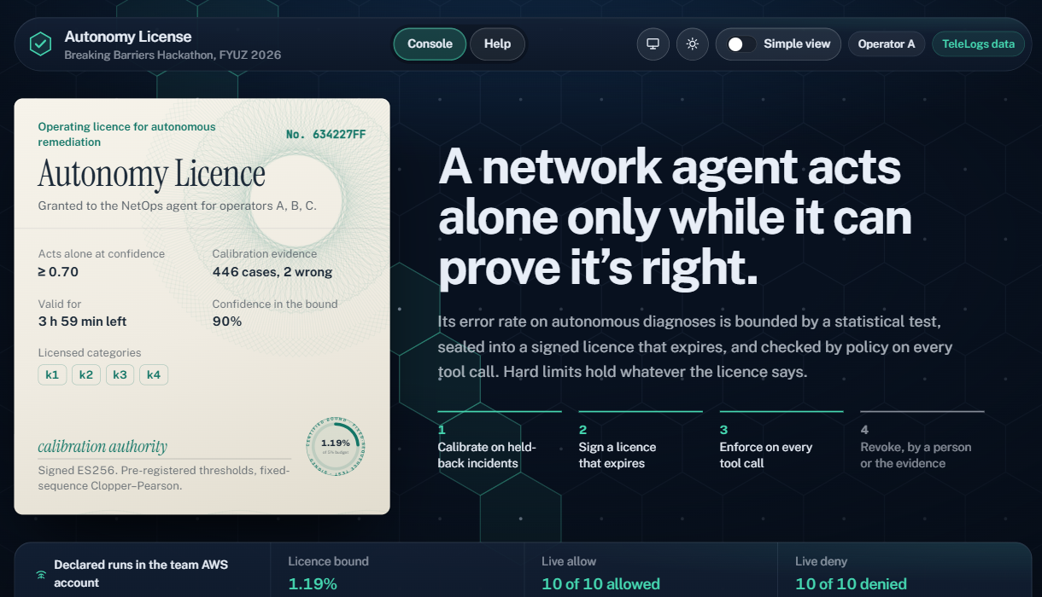
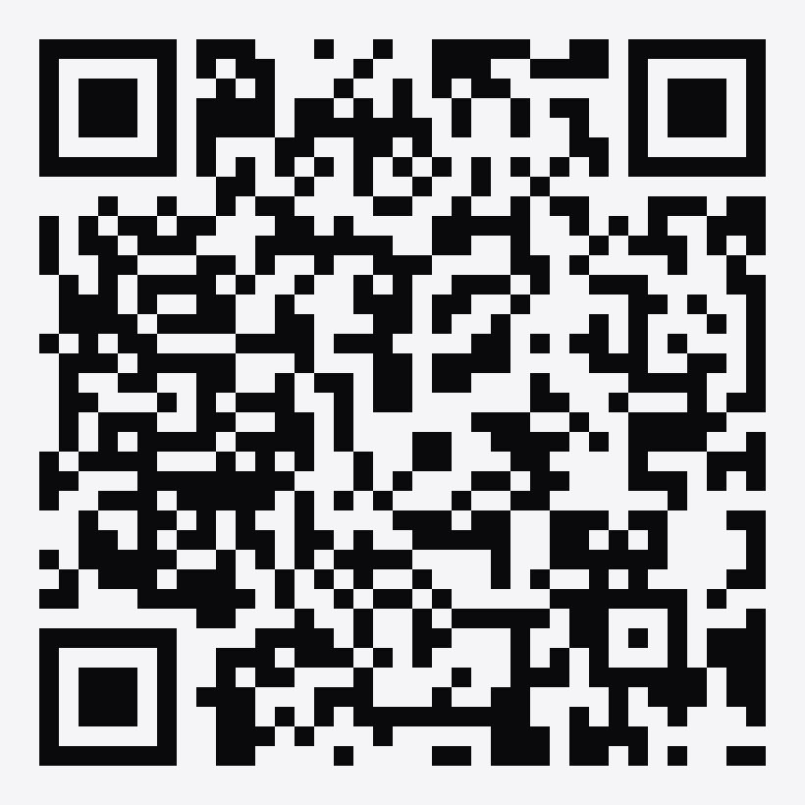
Try it yourself.
Scan to open the console.
d2cs0n7le40uju.cloudfront.net
The public console runs the engine on a simulated network. It doesn’t read the AWS records from the declared runs.
Notes:
And you don’t have to wait for us to show you. Scan this, and the console opens on your own device. Earn a licence, act on it, try to break it, then withdraw it. This public console runs on a simulated network, separate from the declared AWS runs.

Slide 12
Eight declared runs. Eight passes.
1.19%
10/10
10/10
7/7
error bound, against a 5% target
licensed changes applied
oversized changes refused, nothing changed
attacks blocked
5/5
16/16
3/3
11/11
traces complete, in time order
team steps as declared
model-led cases ended under the rules
calls refused after withdrawal
Declared runs in the team AWS account, us-east-2. The network is simulated. Limits are in GAPS.md.
Notes:
Eight runs, each with its target declared before it started, in the team AWS account. All eight pass. One honest note: in the model-led run, all three cases proposed actions outside the licence, so each was refused and queued for a person.

Slide 13
Withdraw the licence. Control goes back to people.
11 of 11 calls refused after the licence and models were withdrawn.
Notes:
And here’s what a risk owner really wants to know. What happens when I say stop? Withdraw the licence, and control goes back to people. The status lives in DynamoDB, so the withdrawal reaches every Lambda at once. We tested it: 11 of 11 calls refused.

Slide 14
Don’t take our word for it.
python tools/rebuild.py
Rebuilds every reported result from the evidence, with no AWS needed.
python tools/show_record.py --run-id … --item …
Follows any one item through the live AWS records, read-only.
Notes:
You don’t have to believe us. Every target was declared before its run. Rebuild reproduces every reported result from the evidence. And the live test follows any one item through the records in AWS.

Slide 15
Exactly what’s proven.
A precise guarantee.
A safe place to test.
The bound covers diagnoses on filtered single-cause incidents, not action safety.
Changes go to a simulator, so the rules were tested without touching a live network.
Earned one network at a time.
Every limit written down.
The classifier was fine-tuned on TeleLogs. Any other network would have to earn its own licence.
Scores were computed once and cached. GAPS.md lists every limit in full.
Notes:
We’re precise about what’s been proven. The bound covers diagnoses. The rules were tested on a simulator, and “resolved” comes from the ground-truth label. These numbers say little about other networks, so any other network earns its own licence. And every limit is written down.

Slide 16
One more thing.
Notes:
There’s one more thing.

Slide 17
The licence can withdraw itself.
A monitor watches outcomes on the trusted side, and pulls the licence when the evidence turns.
Anytime-valid e-process, false revocations at most δ at any stopping time. Tested locally only, not in a declared AWS run. The drift in the demo is synthetic.
Notes:
The licence can also withdraw itself. A monitor watches real outcomes and revokes the licence when the evidence turns, with a guarantee on false revocations at any stopping time. How fast it catches drift depends on the drift. This one is local only, and the drift in the demo is synthetic.

Slide 18



What it changes.
Risk owners
Engineers
Auditors
get a permission they can sign, check and withdraw.
decide what falls outside the licence, and the rest moves on its own.
follow any decision from request to change, under one run id.
Notes:
So what does it change? Risk owners get something they can actually sign, check and withdraw. Engineers decide what falls outside the licence, and the rest moves on its own. Auditors can follow any decision under one run id. That’s the barrier we set out to remove.

Slide 19
Autonomy License.
Proof first. Then action.
team11, Breaking Barriers Hackathon at FYUZ 2026
Notes:
An agent that has to earn its permission, can have it checked on every call, and can lose it at any moment. Autonomy License. Proof first. Then action. Thank you.

